Slide 1
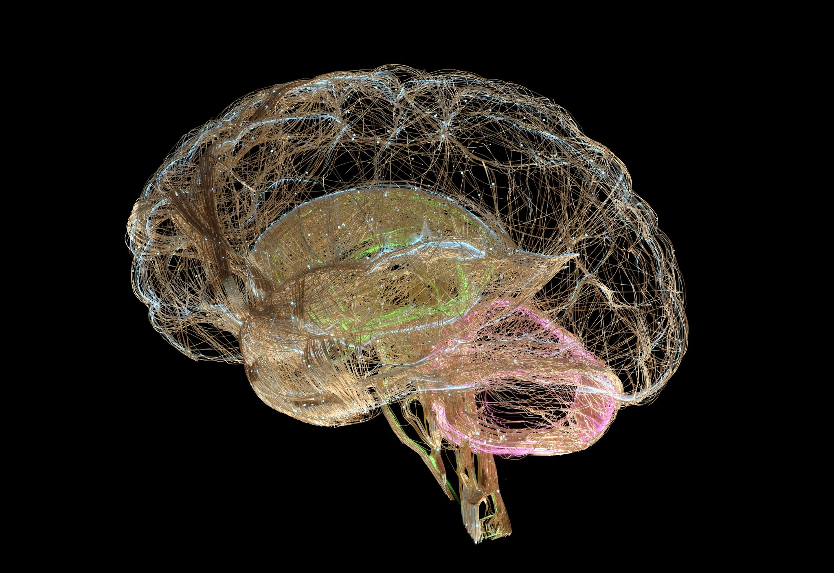

Leveraging Brain chip & Gene editing in everyday life
Akriti Saklani | 221043682
Priya Chaudhuri | 221060736
Yuke Duan | 220819488
Xiaoxia Chen | 220988267
Angelina Ayres | 221048350
Rahik Hasan | 221104138
“The work we submitted as part of this assignment is original, and due credit is given to others where appropriate. We accept and acknowledge that that each member of our team is equally responsible for if the assignment found to be plagiarized in any way, and we will be subject to school’s Academic Integrity policy”

Slide 2

AGENDA
Executive Summary
Introduction
Analysis
Conclusion
Next Steps
Appendix & Reference

Slide 3
Executive Summary
Objectives
Analyze Pew Research data to uncover trends among various demographic groups (age, gender, education, race, income) related to awareness and acceptance of AI and BMS technologies, particularly chip implants and gene editing.
The project will provide critical support for X BMS Corp. by informing strategic decisions in targeting and marketing efforts to enhance the market presence and ensure the successful launch and adoption of the new BMS product.
Key Findings
Age serves as a pivotal driver in AI perception, with younger individuals showing the highest acceptance. Gender-oriented biases indicate that males are slightly more accepting of chip implants. Education demonstrates a strong correlation with AI acceptance, as higher education levels are linked to greater acceptance. Additionally, higher income levels are associated with more balanced and positive outlooks.
We implemented the Random Forest Model for Feature Importance methodology - to understand which questions pose more value to understanding customer opinions.
Based on the feature importance using the model, geography, religion, income and educational level are found to be valuable for understand user viewpoints and the same have been used for designing the recommendations and marketing strategies.
Recommendations
Target Information Campaigns: Provide clear, detailed information about the benefits and safety of the technology
Highlight Positive Impacts: Amplify success stories and positive testimonials to show real-life benefits
Engagement Strategies: Host Q&A sessions, webinars, community forums to engage with different targeted groups and educate new parents through informative pamphlets and personalized consultations in medical and hospital clinics .
Measure and Adjust: Use follow-up surveys and polls to measure changes in perception and acceptance and adjust further strategies. Make sure surveys and polls have questions on patient health to under POV.
Conclusion
Demographic factors significantly influence the acceptance of AI technology. Tailored strategies addressing unique concerns can enhance the adoption of chip implants and gene editing.

Slide 4
Introduction
Background
Artificial Intelligence Market: Chip Implants and Gene Editing.
History:
Brain Chips: Late 20th century
Gene Editing: Early 20th century (CRISPR-Cas9, DNA structure revelation, genetically modified organisms, ZFNs and TALENs)
Market:
Brain Chips: Healthcare, finance, retail, and manufacturing sectors.
Gene Editing: Medicine, agriculture, and biotechnology.
Considerations for Launching AI/BMS Products:
Technological Progress:
AI-integrated biomedical devices enhance precision medicine and personalized healthcare.
Growing market openness to AI chip implants.
X BMS Corp. can leverage this trend for better medical outcomes.
Ethical and Social Environment:
Concerns about "designer babies" and human diversity.
Beliefs influence acceptance of gene editing.
Limited access may exacerbate social inequalities.
Purpose
Analysis:
Public perceptions of chip implants and gene editing technologies by examining the following demographic variables such as :
Age
Gender
Education
Income levels
Aim:
Provide insights to XBMS Corp's launch and adoption of the new product, inform marketing strategies, educational campaigns, and community engagement initiatives.
For actionable insights - Correlation analysis, trend identification, and segmentation to extract actionable insights.
Enhance understanding - Integrate external research and market analysis.
Validate finding, refine strategies, and ensure alignment with organizational objectives - Collaborate with experts and stakeholders for validation and strategy refinement.

Slide 5




Based on the trend analysis on the data and research, we found that:
Age
The elderly (60+) are not as accepting towards newer technologies and express concern regarding AI. Meanwhile younger people are open to adopt AI in their lives.
Gender
Women are less excited than men when the subject of AI comes up.
Education
College graduates are less concerned with AI and its daily application.
This is due to their understanding of AI and education level.
Income
People with lower incomes find themselves in conflict with the acceptance of AI and Technology.
General Observations on AI Perceptions Across Demographics
Across all demographics, the most common perception is being equally concerned and excited about AI.
Concern about AI tends to be higher than excitement.
A portion of each demographic refused to answer.
Targeted communication strategies should address the concerns to shift perceptions towards a more positive outlook on AI.
Implications & Actions
Conduct research to identify specific concerns about AI, such as job displacement, privacy, and ethical issues.
Develop clear, transparent messages addressing these concerns and highlighting the benefits and safety measures in place.
Tailor communication strategies to different demographic groups, using appropriate channels to effectively reach each audience.
Promote positive AI applications and foster public dialogue to build trust and dispel myths.
Notes:
And Concern about AI tends to be higher than excitement. – Priya

Slide 6
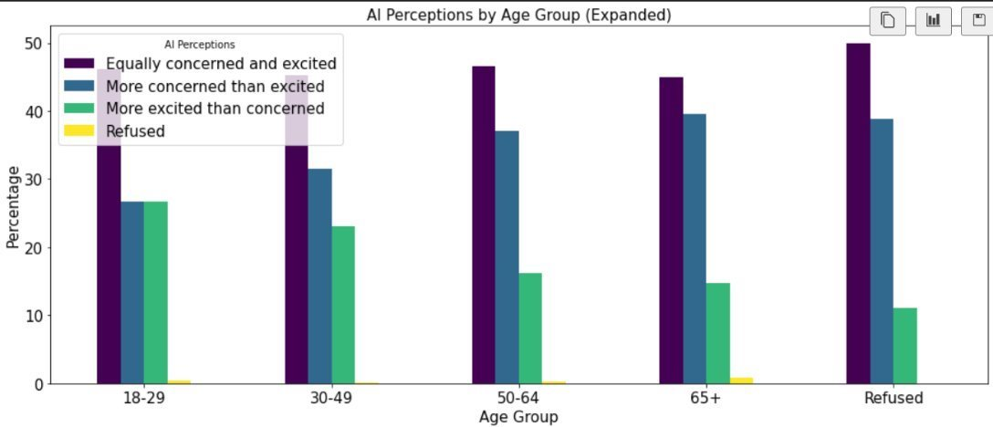
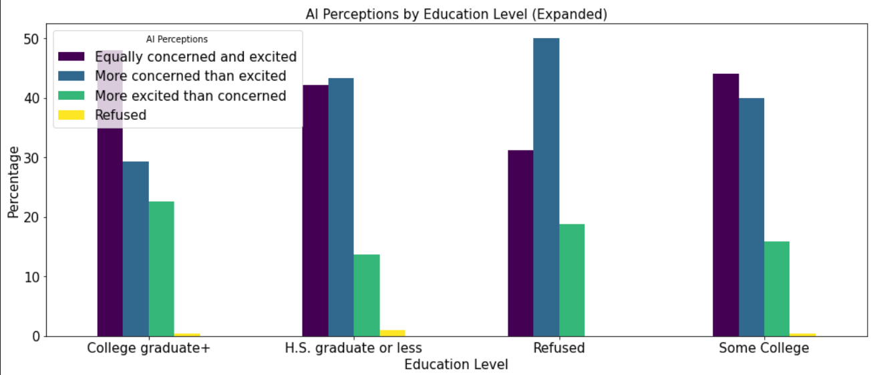
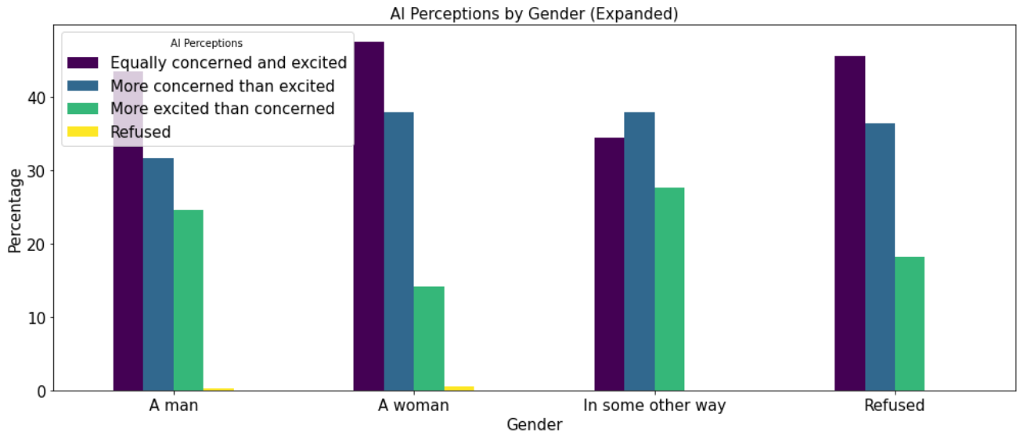
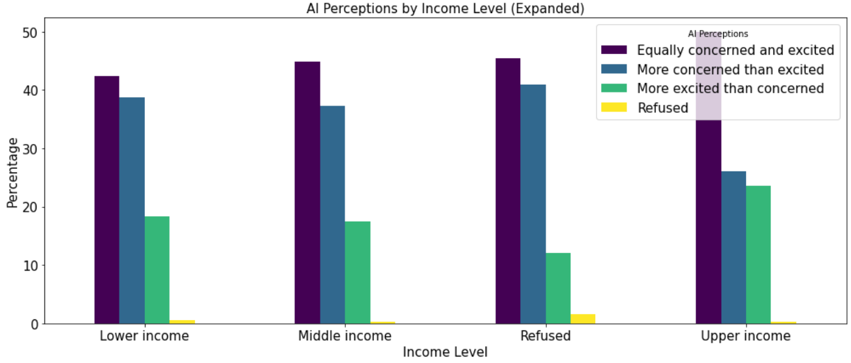
Trend Analysis: General AI Perception

Slide 7
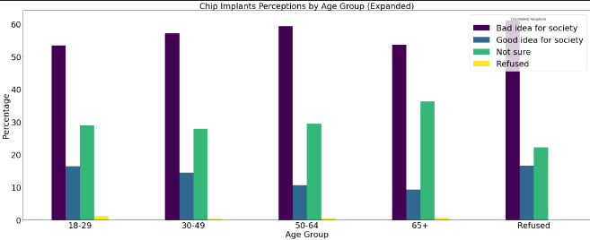
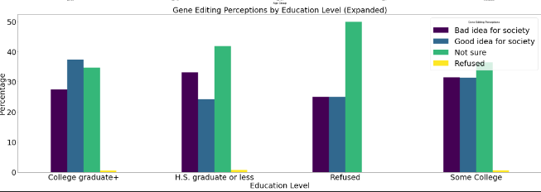
Brain Chip and Gene Editing Analysis
Category | Age | Gender | Education | Income
AI Perceptions | 18-29: High excitement, balanced concern 30-64: Increasing concern 65+: Predominantly concerned | Men & Women: Predominantly concerned, men slightly more excited | College Graduates: More positive H.S. Graduates or Less: Higher concern and uncertainty | Higher Income: More accepting. Lower Income: Predominantly negative.
Chip Implants Perception | 18-29: Mixed, mostly negative 30-65+: Increasing negativity | Men & Women: Predominantly negative, women slightly less so | College Graduates: Balanced but negative H.S. Graduates or Less: Predominantly negative | Higher Income: Balanced, generally negative Lower Income: Predominantly negative and fearful
Gene Editing Perception | 18-29: More positive 30-64: Balanced, less positive 65+: Predominantly negative | Men & Women: Similar trends, men slightly more positive | College Graduates: More positive H.S. Graduates or Less: Higher negativity | Higher Income: Balanced Lower Income: Predominantly negative
Chip Preference Perception | 18-29: More open, mixed views 30-65+: Increasing refusal | Men & Women: Similar, women slightly more open | College Graduates: More open, mixed views H.S. Graduates or Less: High refusal | Higher Income: Balanced, high refusal Lower Income: Predominantly negative
Chip Accuracy Perception | 18-29: Mixed views, some positivity 30-65+: Increasing concern | Men & Women: Similar, men slightly more positive | College Graduates: More positive H.S. Graduates or Less: High negativity | Higher Income: Balanced, high negativity Lower Income: Predominantly negative
Quality of Life Perception | 18-29: More positive about future improvements 30-64: Balanced, less positive 65+: Predominantly negative | Men & Women: Similar trends, men slightly more positive | College Graduates: More positive about future H.S. Graduates or Less: Higher negativity | Higher Income: Balanced views Lower Income: Predominantly negative
NOTE: Individuals who refused to provide demographic information generally exhibit high negativity, fear, and uncertainty across all categories. This group shows the most significant levels of concern and negative perceptions, regardless of the specific technology being discussed. Their high levels of refusal may indicate a lack of trust or understanding, leading to a more negative and uncertain outlook

Slide 8
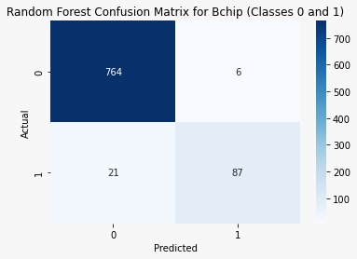
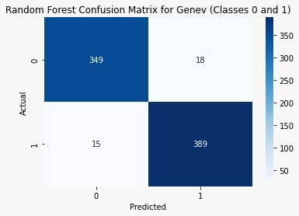
Model Selected
Random Forest Model
Chosen for its highest accuracy score and consistent key performance metrics such as F1, recall and precision scores , as compared to logistic regression and decision tree.
Confusion Matrix Insights:
Class 0 (Bad for Society):
High true negatives indicate many believe gene editing is bad for the society.
Few false positives show some predicted positive actually view it negatively.
Class 1 (Good for Society):
True positives show substantial support for brain chip implants.
Low false negatives suggest few positive views are misclassified.
Model Insights:
Gene Editing Model:
Slightly lower accuracy and precision score than the chip implants model, can be improved for higher accuracy
Balanced in precision and recall
Performs well in identifying positive opinions but has notable false positives and negatives.
Chip Implant Model:
71% accuracy, better than the gene editing model.
High true negatives indicate significant resistance, requiring addressing concerns and misconceptions.
Good overall performance but needs improvement in predicting positive opinions.
Model Limitation:
Data Quality: Missing or inaccurate data can significantly impact model performance.
Overfitting: While Random Forest mitigates overfitting better than a single decision tree, it can still be prone to overfitting if the trees are not pruned
Interpretability: Although Random Forest models provide high accuracy, they are often less interpretable than simpler models like logistic regression, making it harder to understand individual decision paths.
Modeling Analysis
True Negatives (0,0): model correctly predicted that people believe gene editing is bad for society.
False Positives (1,0): model incorrectly predicted that people believe gene editing is good for society, while they actually believe it is bad.
False Negatives (0,1): model incorrectly predicted that people believe gene editing is bad for society, while they actually believe it is good.
True Positives (1,1): model correctly predicted that people believe gene editing is good for society.
Notes:
public acceptance could increase – Akriti

Slide 9

Marketing Insights: Brain Chip and Gene Editing Technology
Based on the feature importance using Random Forest, we found that the below demographics pose the most value when it comes to understanding public viewpoints:
Geography
Both models rank geographical region as the most important feature. This indicates that opinions on gene editing and chip implants vary significantly across different regions.
Income
Income level is a critical factor influencing opinions on both technologies. Higher income levels may correlate with greater acceptance due to better access to information and higher education.
Religion
Prayer frequency and church attendance are significant factors in both models, with religion being highly important for Chip Implants model. This demographic may indicate that highly religious individuals are more likely to have ethical or moral concerns about gene editing and chip implants.
Education
Higher education levels correlate with a better understanding and acceptance of these technologies. Educated individuals are more likely to comprehend the benefits and risks associated with gene editing and chip implants.
To increase acceptance rate, focus on:
Educational campaigns
Highlighting benefits and success stories
Addressing ethical and societal concerns
Engaging early adopters
Continuously adapting based on feedback
This comprehensive, data-driven approach ensures that the marketing strategy is tailored to the audience's needs and concerns, ultimately driving the adoption and acceptance of these innovative technologies.
Collaborate with Hospitals
Partner with OBGNY & Pediatrician
Notes:
Also the Quality of life enhancements and the potential to reduce serious diseases are seen positively, especially among those with higher education levels. – Priya

Slide 10
Marketing Strategy
Geography
Tailor marketing campaigns to address regional differences. Regions more resistant to these technologies may benefit from targeted educational content and testimonials from local influencers or community leaders.
Income
Develop marketing strategies that highlight the affordability and long-term benefits of the technologies.
Offer financing options or discounts to make the technology more accessible to lower-income groups.
Religion
Address ethical concerns directly in communities.
Maintain transparency and create educational content that respects and addresses religious perspectives.
Partner with religious organizations to facilitate open discussions and provide reassurance about the ethical use of these technologies.
Education
Focus on informative and detailed content that appeals to educated audiences.
Highlight scientific research, clinical trials, and expert endorsements to build trust and credibility.
Age
Tailored communication to address the concerns and highlight the positive benefits for the 30-49 and 65+ age groups, which show the highest levels of opposition.
Conduct more educational seminars and offer personalized consultations to discuss individual concerns and provide detailed information.
Target Information Campaigns:​ Provide clear, detailed information about the benefits and safety of the technology
Highlight Positive Impacts:​ Amplify success stories and positive testimonials to show real-life benefits
Engagement Strategies: ​Host Q&A sessions, webinars, and community forums to engage with different targeted groups and educate new parents through informative pamphlets and personalized consultations in medical and hospital clinics.
Measure and Adjust:​ Use follow-up surveys and polls to measure changes in perception and acceptance and adjust further strategies. Make sure surveys and polls have questions on patient health to under POV.
Notes:
It will give the company a better understanding of the viewpoint of the respondent. – Priya

Slide 11
Conclusion
The successful adoption of AI technologies like chip implants and gene editing hinges on understanding and addressing public perceptions.​
Leverage insights to develop targeted strategies​
Address demographic differences​
Tailor communication efforts​
By doing so, we can pave the way for a future where AI technologies are widely accepted and utilized for the betterment of society.​
Next Steps:
Collaborate with domain experts and stakeholders to validate findings, refine strategies, and ensure alignment with organizational objectives and market prospects.
Conduct further analysis to deepen our understanding of market needs and identify new opportunities for growth.
Develop targeted market penetration strategies to expand our presence and solidify our position as leaders in the industry.
Notes:
It will give the company a better understanding of the viewpoint of the respondent. – Priya

Slide 12
APPENDIX & REFERENCES
https://github.com/yuked123/schulich_datascience/blob/main/finalized_code_AI.ipynb (Direct link to code)
https://www.linkedin.com/pulse/genome-editing-simplified-introduction-gene-zalak-shah-ph-d--loqbe?utm_source=share&utm_medium=guest_desktop&utm_campaign=copy

